Slide 1


Analysis and Prediction of Sale Price of a Product in BigBasket
Prepared By : Prasanth Mukkiri
Registration Number : 12210903
Section : K22UP

Slide 2

TABLE OF CONTENT
Problem Statement
Problem Statement Solution and Approach
Abstract
Methodology
Result
Analysis
Conclusion
References

Slide 3
PROBLEM STATEMENT
The BigBasket dataset provides detailed information on a diverse range of products, including pricing, categories, brands, ratings, and descriptions. This project aims to leverage Exploratory Data Analysis (EDA) to uncover patterns and insights that can inform business strategies. Specifically, the analysis seeks to answer the following questions:
Pricing and Discounts
Product Categories and Brands
Customer Ratings
Customer Ratings
Impactful Recommendations
How do the sale prices compare to market prices across different product categories and sub-categories?
What are the patterns in discount amounts and percentages across brands, categories, and product types?
Which categories, sub-categories, and brands have the highest product representation?
Are there specific brands or sub-categories associated with higher discounts or better customer ratings?
What is the distribution of product ratings, and how do ratings vary across different categories and brands?
Are there any relationships between ratings, pricing, and discounts?
What is the distribution of product ratings, and how do ratings vary across different categories and brands?
Are there any relationships between ratings, pricing, and discounts?
How can BigBasket optimize its pricing and discount strategies to maximize revenue and customer satisfaction?
Which underperforming products or brands could benefit from targeted promotions or improvements?

Slide 4
PROBLEM STATEMENT SOLUTION APPROCH
Descriptive Analysis
Insights and Recommendations
Create new columns:
discount_amount = market_price - sale_price
discount_percentage = (discount_amount / market_price) * 100
Categorize products into pricing tiers or rating groups if needed.
Summarize numerical and categorical data to understand distribution and variability.
Identify trends in pricing, discounts, and ratings across categories, sub-categories, and brands.
Visualization
Use plots to visualize:
Price distributions.
Discount trends by category, sub-category, and brand.
Ratings and their relationship with pricing or discounts.
Top categories, sub-categories, and brands based on sales and ratings.
Analyze findings to identify underperforming brands or products.
Provide recommendations on pricing and discount strategies.
Suggest actions to enhance customer satisfaction based on rating patterns.
Dataset Understanding and Cleaning
Load the dataset and explore its structure, dimensions, and column types.
Handle missing values in columns like product, brand, description, and rating based on their significance.
Check for and handle outliers in numerical columns like sale_price, market_price, and rating.
Feature Engineering

Slide 5
abstract
The dataset contains 27,555 entries with 10 columns. Below is a summary of the dataset:
This dataset offers opportunities to explore pricing dynamics, customer behavior, and product performance trends,
forming the basis for actionable business recommendations.
Columns and Descriptions:
Key Observations:
index: Unique identifier for each product.
product: Name of the product.
category: High-level classification of the product.
sub_category: Sub-classification under each category.
brand: Brand name of the product.
sale_price: Actual selling price of the product.
market_price: Original price before discounts.
type: Classification of the product.
rating: Customer rating of the product.
description: Text description of the product .
Missing values are present in product, brand, rating, and description.
Numerical columns (sale_price, market_price, rating) allow for statistical and correlation analysis.
Categorical columns (category, sub_category, brand, type) enable segmentation and comparison.

Slide 6
methodology
Project Title: Exploratory Data Analysis on BigBasket Dataset
Objective: The goal of this project is to perform an Exploratory Data Analysis (EDA) on the
BigBasket dataset to uncover patterns in product categories, pricing trends, and customer
purchasing behavior, and to provide actionable insights for business strategies related to
inventory, marketing, and sales optimization.
Dataset:
• Name: BigBasket Dataset
• Source: Provided dataset containing product details from BigBasket.
• Description: The dataset consists of information related to products available on
BigBasket, including categories, prices, ratings, and availability. The analysis aims to
explore the product diversity, pricing strategies, customer preferences, and other
key insights.

Slide 7
Week 8: Time Series Analysis • If time-related data is available, explore trends over time (e.g., pricing trends, seasonal availability). • Identify patterns or fluctuations in product categories that may correlate with customer purchasing behavior.
Week 9: Insights and Recommendations • Summarize key findings from the analysis. • Provide business recommendations based on insights, such as optimizing inventory for popular product categories, adjusting pricing strategies, or improving customer engagement with highly rated products.
Week 10: Final Report and Presentation • Compile the analysis into a comprehensive report. • Create a presentation that highlights the most significant insights and recommendations. • Prepare to present findings to stakeholders or a class.
Week 1-2: Data Collection and Preparation • Load and explore the dataset to understand its structure. • Clean the dataset: handle missing values, correct data types, remove duplicates, and fix inconsistencies in the product information. • Perform initial data profiling to understand key variables like product categories, prices, and ratings.
Week 3: Data Visualization Basics • Create basic visualizations (histograms, bar charts, box plots) to explore the distribution of individual variables (e.g., product prices, ratings). • Identify any anomalies or outliers in the data, such as extremely high or low prices.
Week 4-5: Univariate Analysis • Analyze individual features like product prices, availability, and ratings. • Explore product categories, identifying which categories have the highest or lowest average prices or availability. • Perform an analysis of ratings distribution across various categories.
Week 6-7: Bivariate and Multivariate Analysis • Examine relationships between multiple variables (e.g., price vs. rating, price vs. availability). • Use scatter plots, heatmaps, and correlation matrices to uncover hidden relationships and pricing trends.

Slide 8
RESULT
The EDA on BigBasket's dataset revealed key insights:
1. Product Distribution: The data showed diverse categories, with some brands
dominating specific sections.
2. Pricing Patterns: Products were often sold at discounts, with notable price variation
across categories.
3. Customer Feedback: Most products received favorable ratings, especially in personal
care and household categories.
4. Popularity: Highly rated and frequently purchased products were identified as the most
popular, while niche products had lower engagement.
5. Multivariate Insights: Premium products tend to have higher prices and better ratings.
These insights can help BigBasket optimize its product offerings, pricing, and customer
satisfaction strategies.

Slide 9
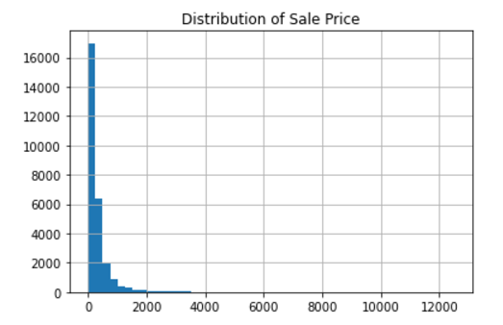
Distribution of sales price

Slide 10
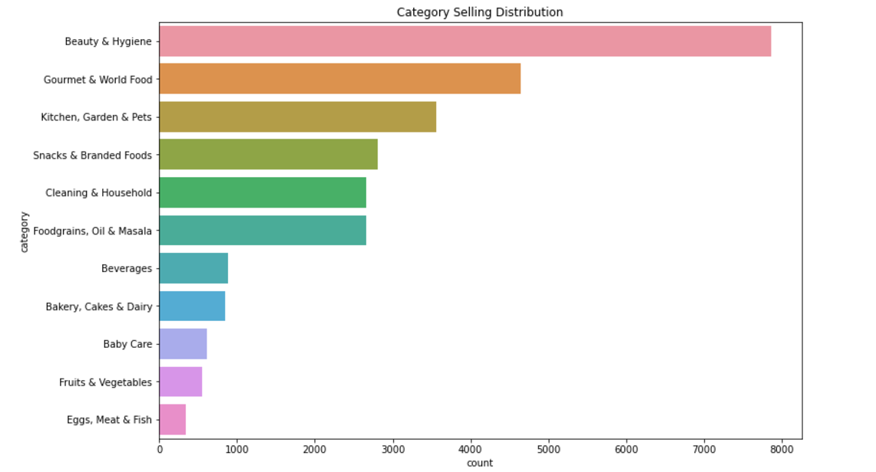
Category Selling Distribution

Slide 11
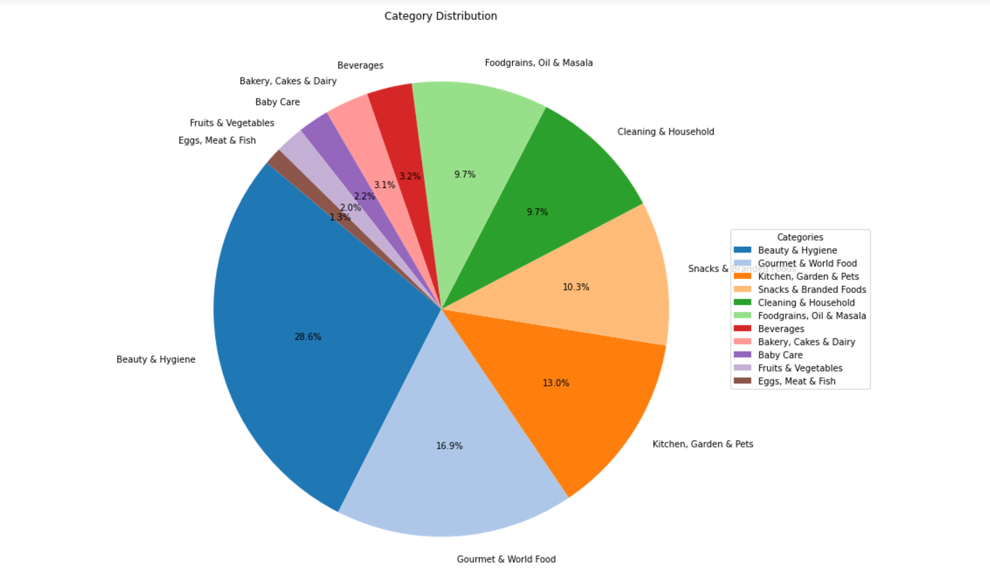
Category distribution in BigBasket

Slide 12
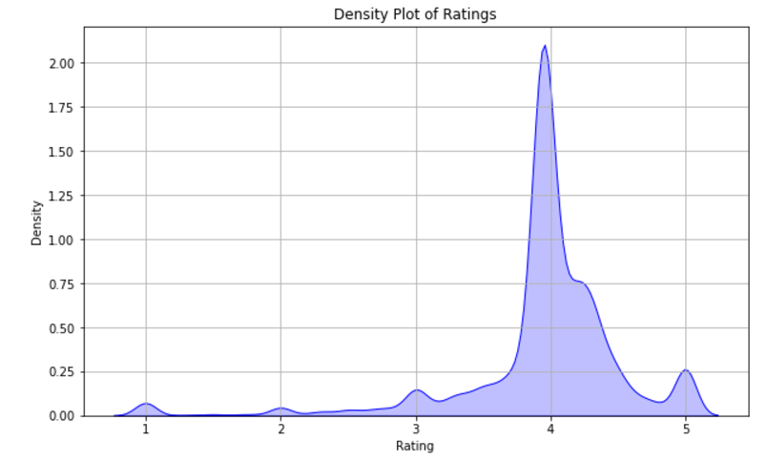
Density plot of ratings

Slide 13
Conclusion
The EDA on the BigBasket dataset provided valuable insights into product attributes, pricing patterns, and customer ratings, uncovering trends essential for business optimization. Key findings included identifying categories and brands offering significant discounts and understanding pricing discrepancies to improve inventory and marketing strategies. Visualizations like bar charts, scatter plots, and box plots effectively highlighted data trends, aiding decision-making. Additionally, a predictive model to estimate sale prices was developed, enabling dynamic pricing strategies to enhance revenue and competitiveness. Overall, the project showcased how data-driven solutions can optimize operations and drive business growth.

Slide 14

References
UCI Machine Learning Repository - Adult Dataset https://archive.ics.uci.edu/ml/datasets/adult
Scikit-learn Documentation
https://scikit-learn.org/
Python Data Science Handbook by Jake VanderPlas
Hands-On Machine Learning with Scikit-Learn by Aurélien Géron
3. GeeksforGeeks Data Science

Slide 15
Thankyou ☺

